Slide 1



Prediction of Network Traffic in Wireless Mesh Networks Using Hybrid Deep Learning Model
Names | IDs
Shady Mohamed Abdel Gawad | 20200246
Mohamed Abdelkader said | 20190459
Hassan Ashraf Hassan Mohamed | 20200151
Gamal Mohamed Gamal | 20200123
Hussein Alyamnii | 20200157
Abanoub Mores Noshy | 20200001
Mostafa Ibrahim El-Sayed | 2020534

Slide 2
Intro:
-In the era of digital expansion, networks play a crucial role, with security, load balancing, maintainability, and speed being key considerations. Among various network topologies, mesh networks stand out for their robust connection and fewer drawbacks in terms of lag and rigidity. Wireless mesh networks, based on the mesh topology, offer easy adaptability and configuration, leading to lower costs and maintenance.
-This paper focuses on wireless mesh networks' traffic prediction, a vital aspect for improving network availability and transmission speeds. The study compares six algorithms Decision Tree Regressor, Linear Regression, Multilayer Perceptron, Poisson’s Regression, Auto Regressive Integration and Moving average, and Long Short Term Memory – applied to real-world data.

Slide 3
-The research proposes a hybrid technique for network traffic prediction in wireless mesh networks, specifically using historical data from High-Speed Diesel (HSD) pumps. Sensors collect data, forming a mesh network indicative of typical traffic scenarios. The collected data undergoes multivariate time series analysis using statistical and machine learning algorithms.
-The paper introduces a novel Convo-LSTM architecture for wireless mesh network traffic prediction, leveraging the strengths of Convolutional Neural Networks (CNN) for feature engineering and Long Short Term Memory (LSTM) for time series sequences. The proposed model is evaluated based on Mean Square Error, Mean Absolute Error, and Root Mean Square Error to assess its performance.
-Key contributions of the paper include the introduction of a hybrid model for wireless mesh network traffic prediction, the implementation and comparison of various statistical and machine learning algorithms, and an unbiased analysis of their performance. The paper outlines the review of previous work, details the data collection process, describes analysis methods, presents and analyzes results, and concludes with insights for researchers in the wireless mesh network domain.

Slide 4
- This research proposes a hybrid model for predicting wireless mesh network traffic, implements and evaluates algorithms for multivariate time series data, conducts an unbiased analysis of their performances, and provides valuable insights for researchers in the wireless mesh network domain. In summary, the paper presents solutions to address challenges in wireless mesh networks, offering comparisons and insights for both researchers and practitioners in the field.

Slide 5
II. Background work:
- Network traffic prediction and routing have been extensively studied, incorporating various time series models, machine learning algorithms, and deep learning methods such as ARIMA, GARCH, and wavelet-based transformations. combined ARIMA and GARCH models for network traffic prediction, reflecting the diverse range of approaches in this field.
- Neural networks, including deep learning techniques, have played a pivotal role in network analysis and prediction for nearly a decade, despite the initial preference for time series models like ARIMA. This shift highlights the evolving landscape of methodologies employed in understanding and forecasting network traffic.
- Applied a multi-resolution neural network for the same task. And utilized a flexible neural tree to resolve traffic issues in small-scale networks . Studies have extensively compared the performance of traditional methods and deep learning networks in traffic prediction.

Slide 6
- Applied various sequence models, including LSTM, RNN, and IRNN, for network traffic prediction. Similar traditional and advanced approaches have been employed for traffic prediction in wireless networks. A hybrid ANN-based approach is proposed for traffic prediction. A hybrid model using CNN and LSTM is proposed for traffic flow prediction.
- A model for the daily prediction of COVID-19 cases for the next 50 days was recently developed and implemented.
- Deep belief networks were initially used for wireless backbone networks and later enhanced their operation through reinforcement learning in an IoT setting. Deployed RNNs in a Spartoi-temporal sense for improved traffic prediction performance.
- Researchers have observed the rise of attention mechanisms and deep learning in interdisciplinary applications.
- Applied a meta-learning scheme for faster traffic prediction in smaller networks. combined wavelet analysis with backpropagation neural networks for traffic flow analysis in wireless networks. A quantum-PSO approach has been explored in the domain of traffic prediction.

Slide 7
- Industry 4.0 is characterized by connectivity, data volume, tech gadgets, inventory reduction, customization, and controlled production. Analyzed recent advancements in smart monitoring and data analytics for infrastructure predictive maintenance (PdM). PdM relies on data-driven insights to prevent downtime through maintenance, protection, and repairs. Emphasized the redefining of business in all industries with the emergence of AI and IoT.
- Artificial neural networks and evolutionary algorithms are common AI techniques for machine diagnosis . Predictive maintenance reduces accidental device downtime, lowers maintenance costs, and extends equipment life cycle.
- The fundamental infrastructure of an IoT framework includes sensors, actuators, computation servers, and the communication network. The TCP/IP communication protocol transmits sensor data in IoT frameworks.
- The challenges faced by IoT devices located in geographically separated locations, communicating primarily via wireless media, were highlighted. And for example, on these challenges ; wireless channels are known for significant distortion levels and instability, posing challenges for IoT communication. For this reason , reliable data transfer without excessive retransmissions is a significant concern in the analysis of IoT devices.

Slide 8
- The fundamental infrastructure of an IoT framework includes sensors, actuators, computation servers, and a communication network. Mobile ad hoc networks (MANETs) are its backbone. MANET nodes with mesh architecture can spontaneously connect with other nodes, requiring minimal infrastructure. MANET nodes operate on the IoT network and collect data from sensors, RFID-enabled nodes. MANET nodes, which are similar to sensor nodes, are important in many IoT applications, and form a MESH network.
- Researchers have worked on IoT using mature technologies like RFID, Wireless Sensor Network (WSN), and Mobile Adhoc Network (MANET). An IoT-based cloud network architecture is proposed, combining IoT and deep learning. The same architecture is suggested for applications beyond healthcare, such as traffic analysis, smart farming, and weather forecasting.
-WSNs are identified as significant enablers of IoT models since their inception. In WSNs, sensor nodes work together to gather and send data to the sink node, but nodes do not have a direct internet connection. WSNs have been observed to contain sensor nodes for sensing and communication, with sensors adapting to uneven and irregular deployment structures.

Slide 9
- The IoT transforms everyday objects into connected devices, envisioning widespread Internet connectivity. The fundamental methodology of IoT involves transmitting large amounts of sensitive data to detect the surrounding situation, communicate precise information, and provide feedback to nature.
- The use of telecommunications has become common in the Internet of Things to meet the requirements of adaptability and versatility in our daily lives. Cellular innovations such as 3/4/5G are based on interface separation for large devices, requiring framework support and legally permissible spectrum.
- It has been noted that work on traffic forecasting has limited focus on historical data, highlighting the critical need for flexible and appropriate models.

Slide 10
III. DATA COLLECTION AND PREPROCESSING:
Data Collection
Duration: Over a year
Using a set of HSD pumps
Eight sensors in a wireless mesh network
8960 tuples: Date/Time, 7 input variables (3-phase Current, 3-phase Voltage, Temperature), 1 output variable (Vibration sensor reading)
Split: 80% training, 20% test data

Slide 11
Data Preprocessing
Check for Time Series Stationarity
Verify Consistent Mean and Standard Deviation
ADFuller Test for Stationarity
Null Hypothesis: Non-stationary series
Alternative Hypothesis: Stationary series
P-value threshold: 0.05
Conclusion: Series is stationary
Application of Seasonal Decompose Method
Obtain Residuals, Seasonality, and Trends
Utilized for setting up stationary time series for forecasting

Slide 12
Time Series Stationarity Check
Importance in data analysis
Verification methods: Mean, Standard Deviation
ADFuller Test
Hypotheses explanation
P-value threshold and significance
Conclusion based on test result
Seasonal Decompose Method
Purpose and application
Obtained components: Residuals, Seasonality, Trends
Usefulness in establishing a stationary time series

Slide 13
Traffic Modeling
Importance in network planning and anomaly detection
ARIMA model overview
AI-based regression models for traffic forecasting
Internet Traffic Prediction
Importance in resource allocation and congestion prevention
Short-term vs. Long-term prediction
Traditional models (Poisson regression, AR, ARIMA) limitations
Significance of Traffic Forecasting
Impact on network optimization
Benefits in resource allocation and congestion management
Limitations of Traditional Models
Addressing Short Range Dependencies (SRD) vs. Long Range Dependencies (LRD)
Future Directions
Exploration of advanced forecasting techniques
Integration of AI for improved traffic predictions

Slide 14
IV. ALGORITHMS USED FOR TRAFFIC PREDICTION:-
- The discussed section explores two main types of traffic prediction models: parametric and non-parametric. Parametric methods involve creating a flexible family of models, estimating parameters with training data, and making forecasts. The Auto-Regressive Integrated Moving Average (ARIMA) and artificial intelligence-based regression models, like those detecting complex correlations automatically, are highlighted for traffic forecasting. Predicting Internet traffic is crucial for network planning and resource optimization, addressing issues such as congestion and bandwidth waste. Short-term and long-term predictions are distinguished, with traditional models like Poisson regression and ARIMA noted for their limitations in handling Long Range Dependencies (LRD) in Internet traffic forecasting despite widespread use.

Slide 15
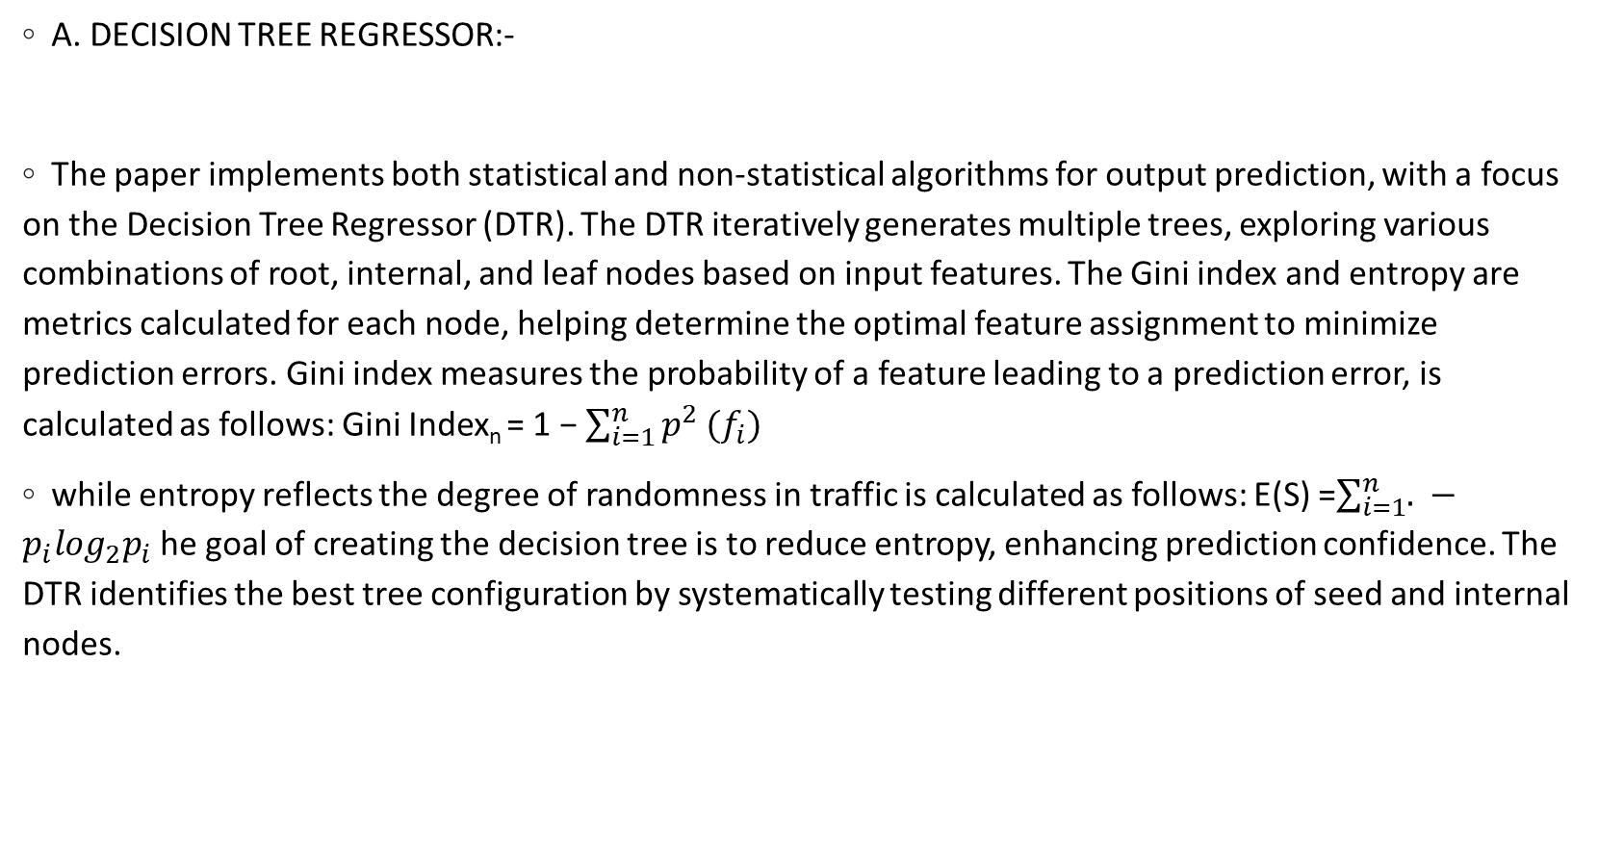
A. DECISION TREE REGRESSOR:-
The paper implements both statistical and non-statistical algorithms for output prediction, with a focus on the Decision Tree Regressor (DTR). The DTR iteratively generates multiple trees, exploring various combinations of root, internal, and leaf nodes based on input features. The Gini index and entropy are metrics calculated for each node, helping determine the optimal feature assignment to minimize prediction errors. Gini index measures the probability of a feature leading to a prediction error, is calculated as follows: Gini Index_{n} = 1 − $\sum_{i=1}^{n}{p^{2}}(f_{i})$
while entropy reflects the degree of randomness in traffic is calculated as follows: E(S) =$\sum_{i=1}^{n}{. }−p_{i}\log_{2}p_{i}$ he goal of creating the decision tree is to reduce entropy, enhancing prediction confidence. The DTR identifies the best tree configuration by systematically testing different positions of seed and internal nodes.

Slide 16
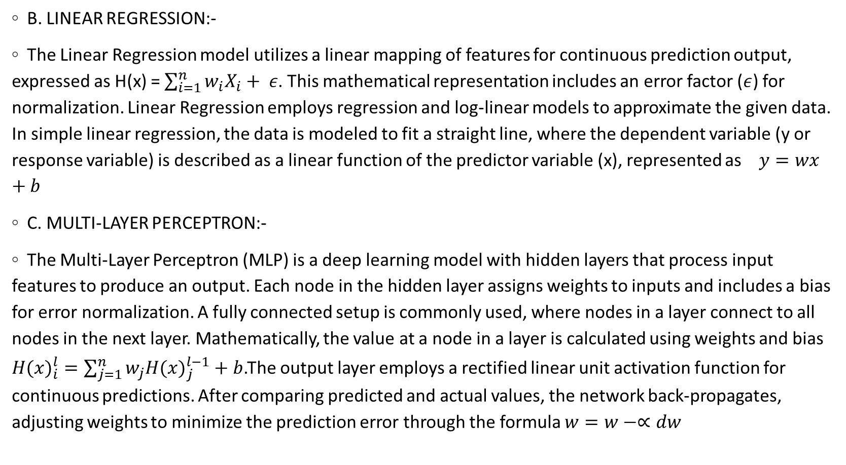
B. LINEAR REGRESSION:-
The Linear Regression model utilizes a linear mapping of features for continuous prediction output, expressed as H(x) = $\sum_{i=1}^{n}{w_{i}X_{i}}+ ε$. This mathematical representation includes an error factor ($ε$) for normalization. Linear Regression employs regression and log-linear models to approximate the given data. In simple linear regression, the data is modeled to fit a straight line, where the dependent variable (y or response variable) is described as a linear function of the predictor variable (x), represented as $y=wx+b$
C. MULTI-LAYER PERCEPTRON:-
The Multi-Layer Perceptron (MLP) is a deep learning model with hidden layers that process input features to produce an output. Each node in the hidden layer assigns weights to inputs and includes a bias for error normalization. A fully connected setup is commonly used, where nodes in a layer connect to all nodes in the next layer. Mathematically, the value at a node in a layer is calculated using weights and bias ${H(x)}_{i}^{l}=\sum_{j=1}^{n}{w_{j}{H(x)}_{j}^{l−1}+b}$.The output layer employs a rectified linear unit activation function for continuous predictions. After comparing predicted and actual values, the network back-propagates, adjusting weights to minimize the prediction error through the formula $w=w−∝dw$

Slide 17
D. POISSON REGRESSION
The Poisson regression is a probabilistic model . It use a probabilistic mass function (PMF) to check what could be the probability of observing a particular continuous for a given input a set of variables
X ∈ [X₁, X₂, .., X_{n}]. This function is defined as follows:
PMF(yi|xi) = (e^−λi ∗ λi^yi)/yi!
where λ_{i} is the mean rate and this output for a given input x is defined as follows:
λ_{i} = e^{x}iβ
Here, β is the regression coefficient.
The best β when the slope of the PMF curve is minimum, which is better derived by taking derivatives of the logarithm of PMF. This derivative
equation is as follows:
n(PMF) = n ∑ x=1 (yixiβ − exiβ − lnyi!)

Slide 18
AUTO REGRESSIVE INTEGRATION AND MOVING AVERAGE
ARIMA model using two algorithms Moving Average and auto-regression get future predictions from past time series value . Mathematically, it is represented as
follows:
h_{t} = α + β₁Y_{t−1} + β₂Y_{t−2} + . . . + β_{p}Y_{t−p}‹_{t}
y_{t} = h_{t} + φ₁‹_{t−1} + φ₂‹_{t−2} + . . . + φ_{q}‹_{t−q}
There are some terms based on auto-regression and some terms based on moving average. If terms in the time series are under-different, add more AR terms, and in cases of excess difference, then add more MA terms.
The difference between auto-regression and moving average is that auto-regression uses past values of the variable to predict its future values, while moving average uses past errors of the variable to predict its future values.
Use ARIMA (p, d, q) method if the non-stationary problem, if stationary without lag, use ARMA (p, q) method

Slide 19
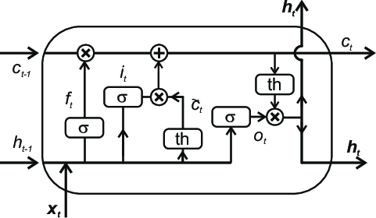
LONG SHORT TERM MEMORY
Long Short-Term Memory is a recurrent network-based architecture where it have three gates: forget, update, and output gates every point in the state.
Forget to let go of some information, update some pattern information, or output any new information.
the given input for a time series input X_{i} and intermediate output h_{t} .
f_{t} = σ (α_{f} x_{t} + β_{f} h_{t−1})
o_{t} = σ (α_{o}x_{t} + β_{o}h_{t−1})
FIGURE 5. Block diagram of LSTM architecture.

Slide 20

CONVO-LSTM :
INTRO:
”Convo-LSTM: Integrating CNN and LSTM for Network Traffic Prediction”
1 - "Computational Analysis: Forward and Backward Propagation in Convo-LSTM"
-the aggregate number of multiplications and additions in layer 1

Slide 21
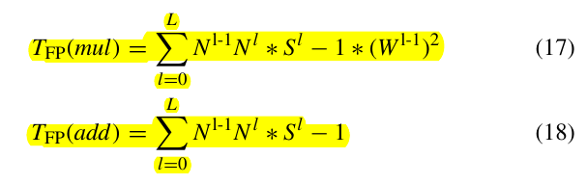
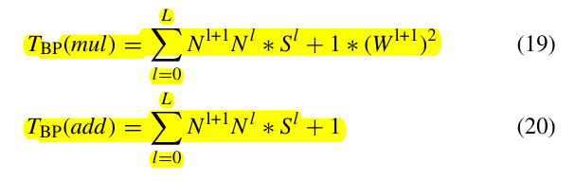
T(mul) & T(add) in CNN layer 1 :
Similarly, at backpropagation :

Slide 22

Total number of multiplications and additions will be, respectively:
2) STATISTICAL ANALYSIS
"CNN Architecture: Extracting Features for Time Series Forecasting"
------
3) SAMPLE DATA SET DESCRIPTION
"Dataset Overview: Wireless Mesh Network Traffic Prediction":
Data Collection Overview
Sensor Information and Parameters
Model Configuration and Layer Transformations

Slide 23
This is equated to zero to find the best β value. This value is then used to derive the prediction for a new test input x_{p}:
y_{p} = λ_{p} = e^{x}pβ
Convert the data set into only numeric values.
The data set should contain only non-negative integer values that represent the frequency

Slide 24
V. RESULTS:
The result section in paper compares seven different methods for predicting the performance of a case study of a wireless mesh network (High-Speed Diesel pump) based on the vibration parameter:
The case study involves a network of sensors that measure the three-phase current, voltage, temperature, and vibration of a High-Speed Diesel (HSD) pump.
the comparison between the predicted and actual output for each method.

Slide 25
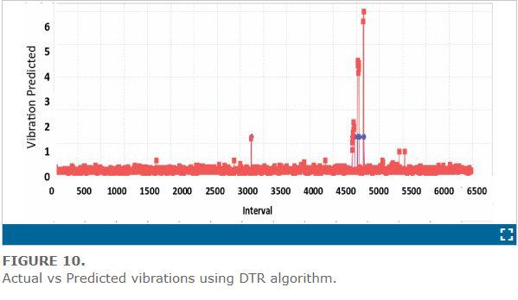
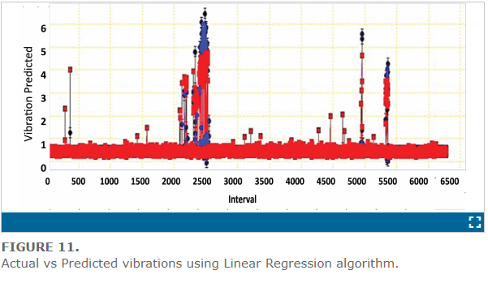
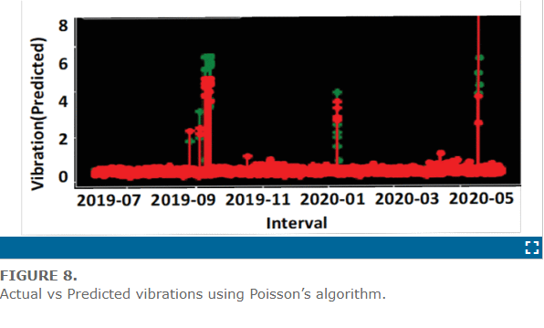
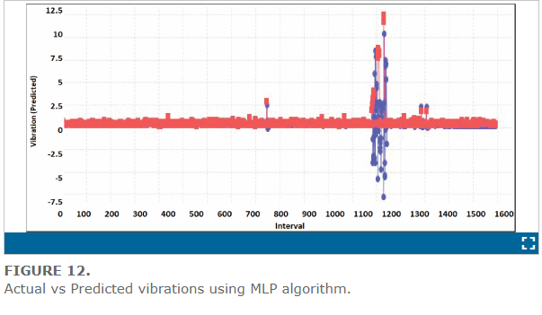
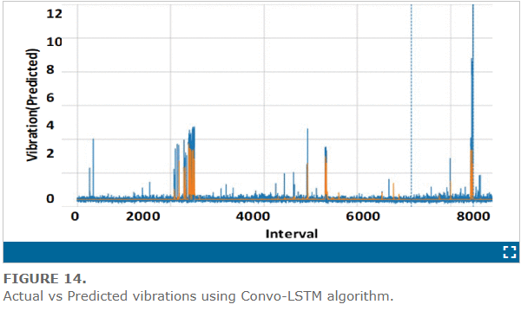
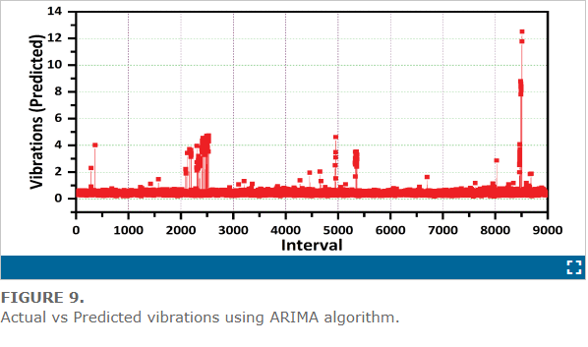
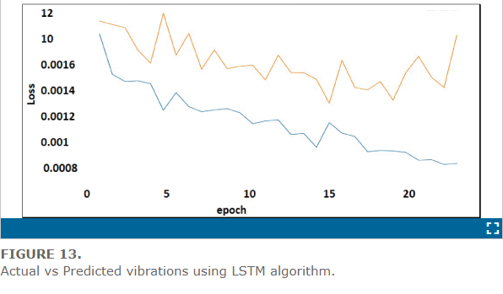
1-DTR- Decision Tree Regressor, 2-LR- Linear Regression,3- MLP- Multi-layer Perceptron, 4-Poisson Regression, 5-ARIMA- Auto-Regressive Integrated Moving Average,6- LSTM- Long Short-Term Memory, and 7-Convo-LSTM- Convolutional Long Short-Term Memory.

Slide 26
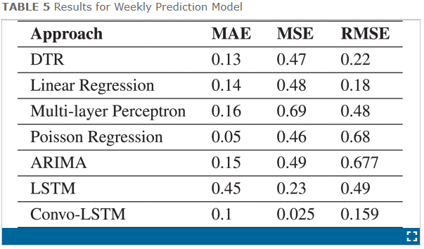
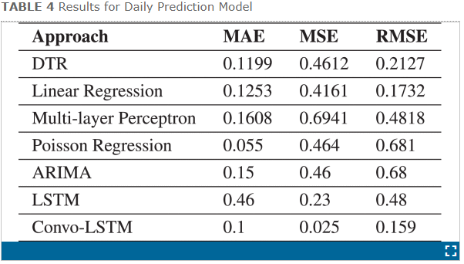
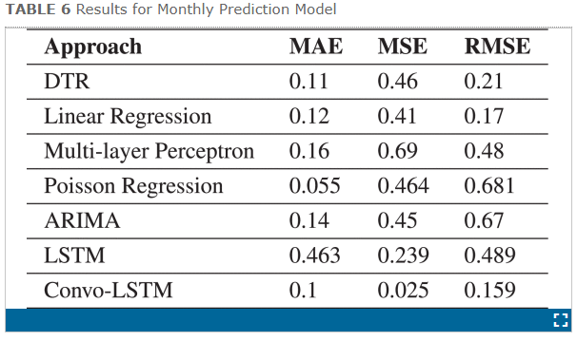
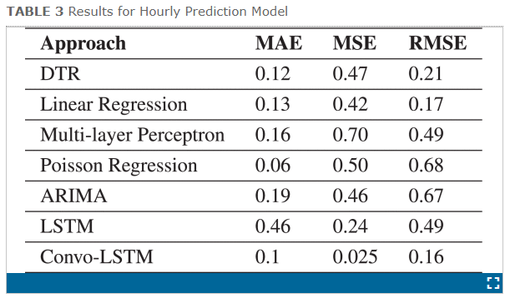
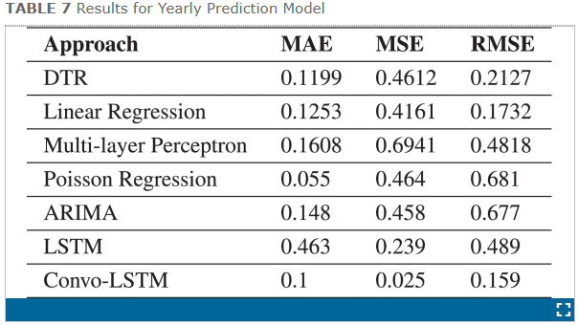
The authors use historical data from the sensors to train and test different machine learning and deep learning algorithms for predicting the vibration parameter as the output.
The authors evaluates the models across five different time intervals: hourly, daily, weekly, monthly, and yearly.

Slide 27
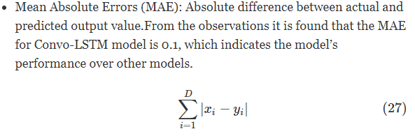
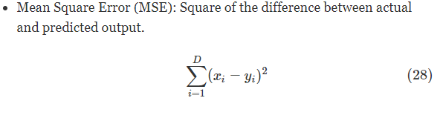
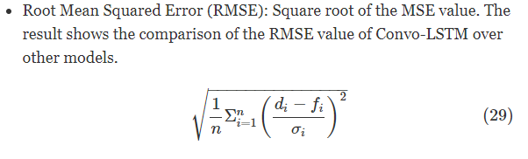
The authors uses three metrics to measure the accuracy of the predictions: MAE- mean absolute error, MSE- Mean Square Error, and RMSE- Root Mean Squared Error.

Slide 28
It is found that the MAE for the Convo-LSTM model is 0.1, MSE is 0.025, and RMSE is 0.16, which indicates the model’s performance over other models.
Convo-LSTM has the best performance among all the methods, with the lowest values of MAE, MSE, and RMSE across all the time intervals.

Slide 29
VI. CONCLUSION
The paper introduces a hybrid model for predicting traffic in wireless mesh networks. It employs regression methods on system configuration parameters using six algorithms: decision tree regressor, linear regression, multi-layer perceptron, Poisson regression, ARIMA, and LSTM. The study focuses on three main feature types—three-phase current, three-phase voltage, and temperature—to forecast the vibration output of the HSD Pump. Additionally, the paper proposes a novel Convo-LSTM setup, demonstrating its effectiveness. Evaluation across various intervals reveals that the Convo-LSTM algorithm outperforms others, especially in time-series multivariate datasets resembling wireless mesh networks. The findings suggest potential applications in predicting network traffic volume. The paper also discusses future directions, including exploring contemporary methods like attention mechanisms and transformers for traffic prediction. It suggests proposing multimodal networks that combine physical configuration values and network system log values, anticipating the growing complexity of larger and more distributed network systems. Automated prediction of incoming traffic and resource allocation is identified as a crucial need for the evolving landscape of network systems.

